Slide 1


Slide 2
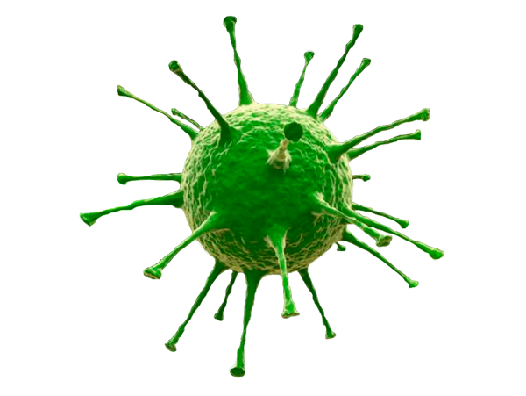
CANINE PARVOVIRUS DETECTION SYSTEM
-- Pooja Sawant

Slide 3
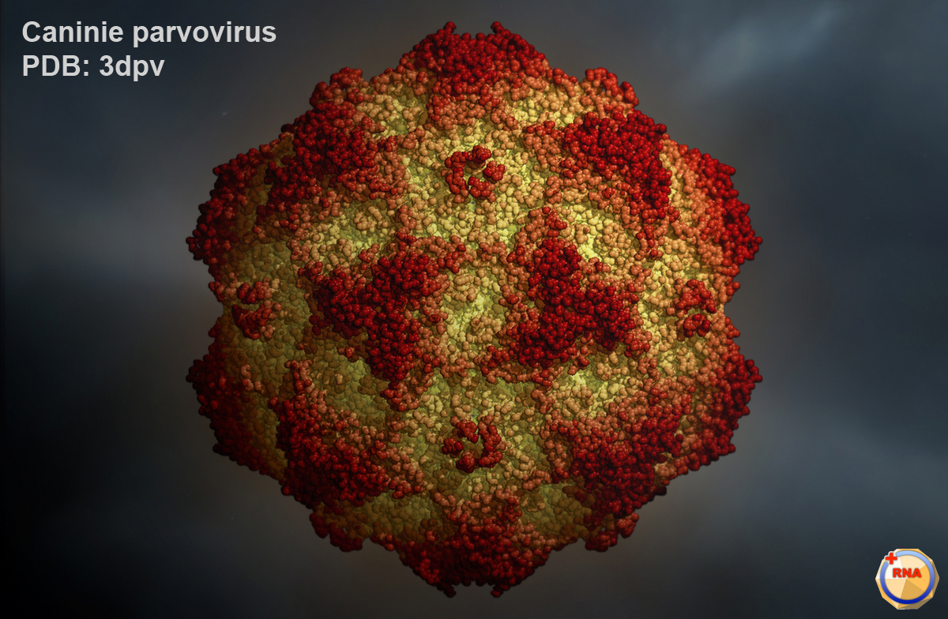
What is ParvoVirus???

Slide 4

Parvovirus has been in the United States since the 1970s.
Parvovirus is one of the most deadly of viruses affecting dogs.
It attacks the white blood cells.
It causes serious damage to the intestinal tract and sometimes the heart

Slide 5

Why Parvovirus ???

Slide 6
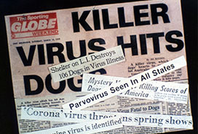
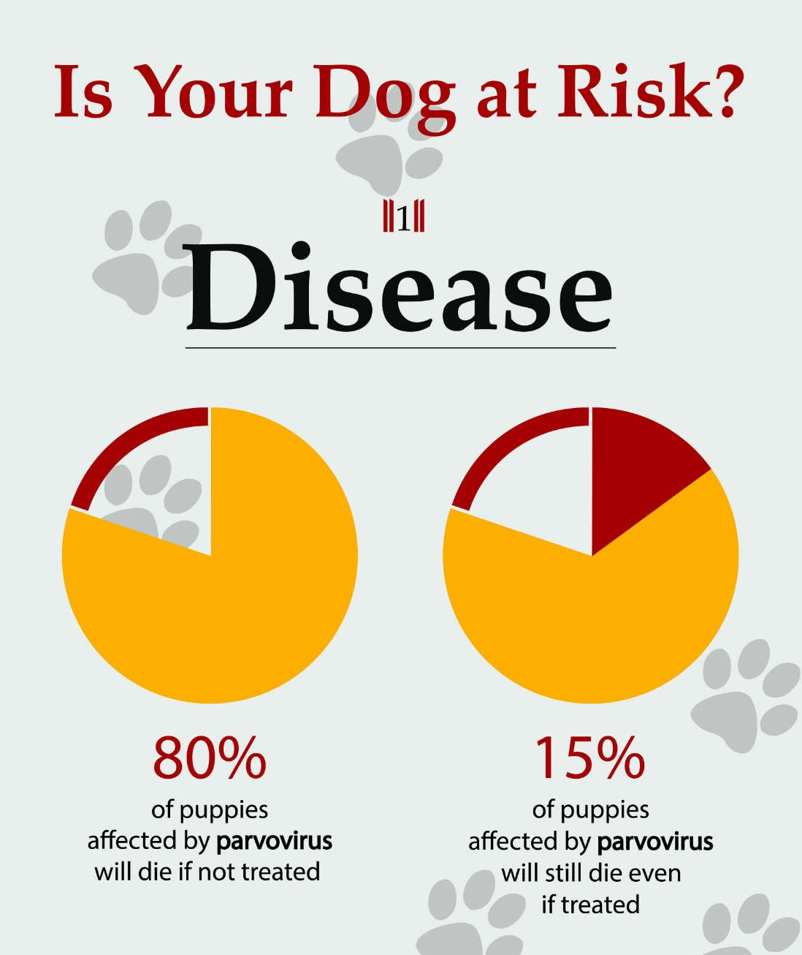
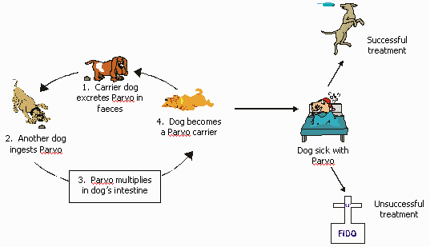

Slide 7

One of the most frightening words a pet owner can hear is parvo.
Once infected, it often takes a serious turn within a matter of 3-7 days.
With aggressive veterinarian care about 80% of the dogs can be cured.
This is why catching the onset of symptoms and responding with emergency veterinary care is so important.

Slide 8
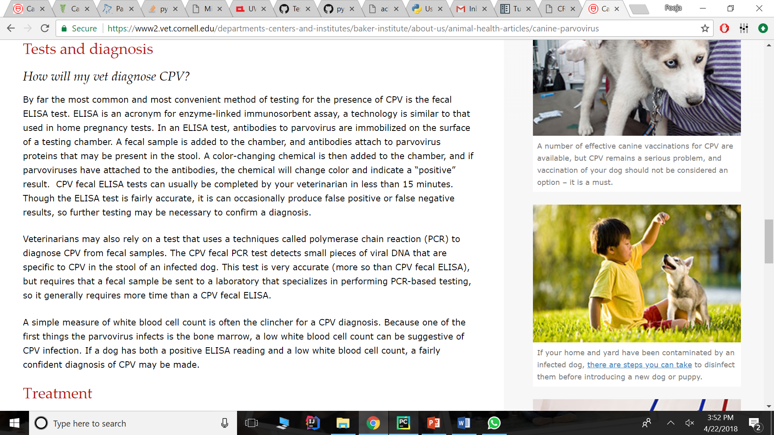
INPUT NODES
Dog’s Age
Physical Examination
Lethargy
Diarrhea
Vomiting
Anorexia
Fever
Severe Weight Loss
Skin Tenting
Tacky gums
Presence of ticks
Another Health Condition
Laboratory Tests
ELISA test
WBC Count
Environment
Parvo
Veterinarian Visit
Treatment Possible

Slide 9
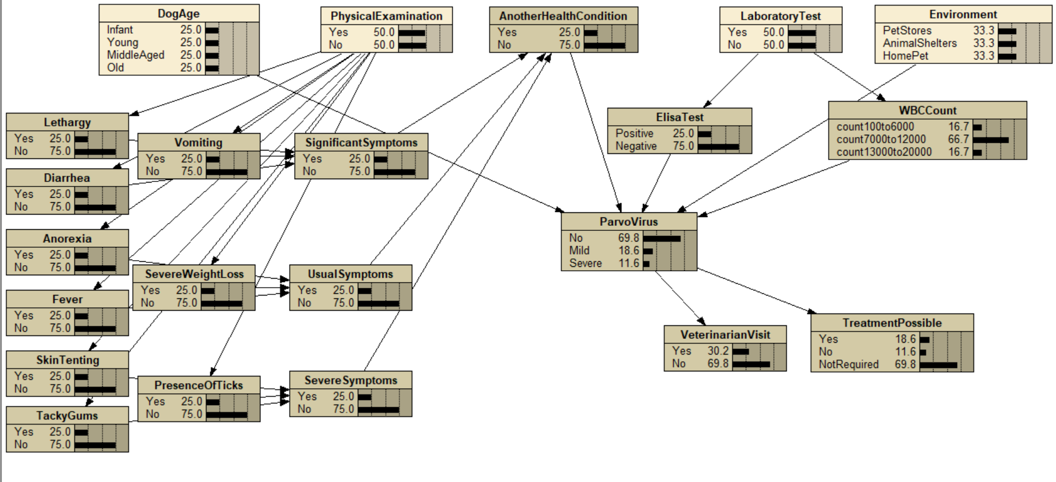
Prototype
Bayesian Network in NETICA

Slide 10


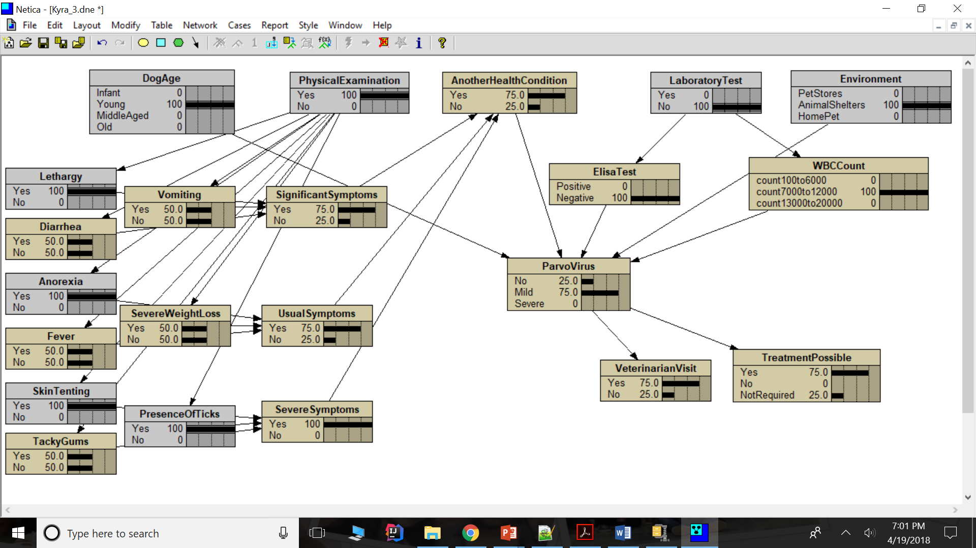




Slide 11
FUTURE SCOPE
Can generalize the prototype for other canine-related diseases.
Can increase the scope of current prototype.
Add treatment medications prescribed.
Add Vaccinations given for a particular strain.
Add more medical aspects.

Slide 12
http://vetfolio-vetstreet.s3.amazonaws.com/2a/c3dfa0a9a611e087120050568d3693/file/VT0511_Tabor_CE.pdf
https://www.ncbi.nlm.nih.gov/pmc/articles/PMC3550768/
https://www.avma.org/public/PetCare/Pages/Canine-Parvovirus-FAQs.aspx
http://www.maddiesfund.org/an-historical-timeline-of-canine-parvovirus.htm
http://www.billingsanimalfamilyhospital.com/blog/parvo-and-the-importance-of-prevention/#.Wtjq84jwY2w
https://www2.vet.cornell.edu/departments-centers-and-institutes/baker-institute/about-us/animal-health-articles/canine-parvovirus
Reference

Slide 13
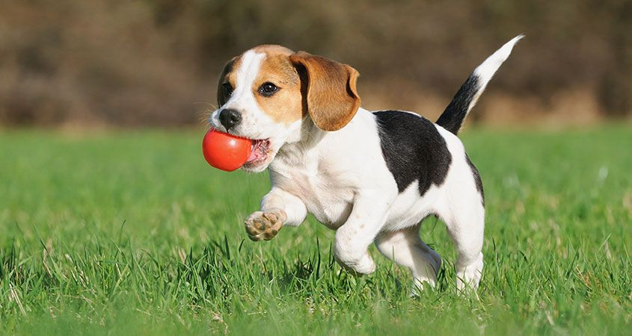
Thank You !!!

Slide 14

Questions ???

